Slide 1
Automated Attenndance System

Slide 2
Time line:
01
Face and Eye detection
04
Store Face Encodings
02
Face Recognisation
05
Design Front End and Connect Backend
03
Create Database
06
Implement and Debugging

Slide 3
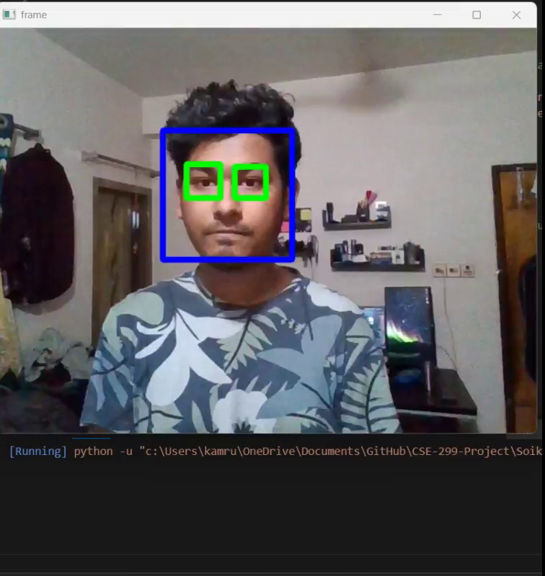
Week 01 Face Detection Using OpenCV

Slide 4
System
Our day to day laptops were stuggling to keep up
Pointing Issues:
Classifiers
Classifiers of OpenCV wasn’t working great
Knowledge
Limited Knowledge in Python
Learning
Resources Were Scatterded

Slide 5
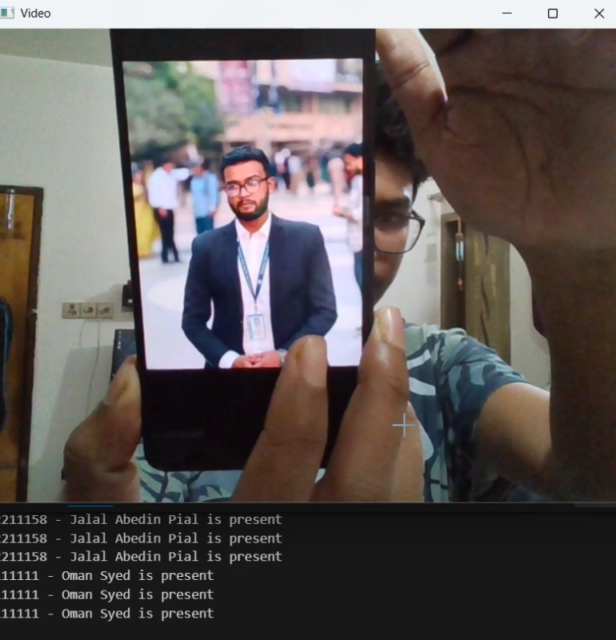
Week 02 Face Recognisation

Slide 6
Pointing Issues:
Enviroment
python, opencv, dlib, numpy
Deep Learning
We went on a different path from deep learning
Learning

Slide 7
Machine Learning Infographics
Artificial intelligence
Machine learning
Deep learning

Slide 8
Next 2 Week’s Plan:
04
Presentation
03
Import Face Encodings in to database
02
Figure out structure of the database we need and create database
01
Find out the efficient way to store Face Encodings

Slide 9
Thank You!

